Slide 1

Importance of SSH and its Use in GitHub
Notes:
<number>

Slide 2
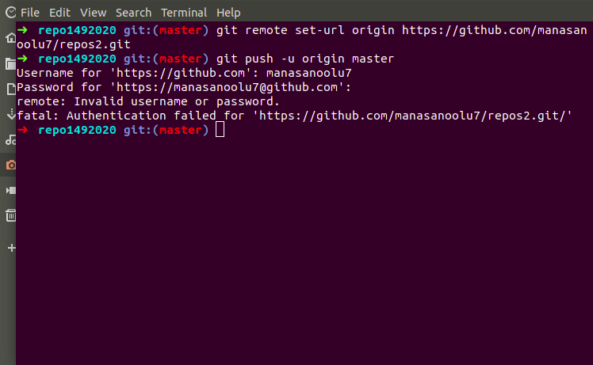

Slide 3
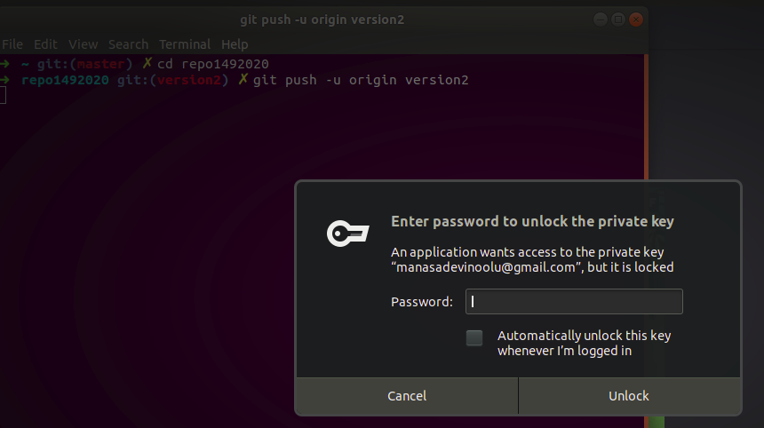

Slide 4
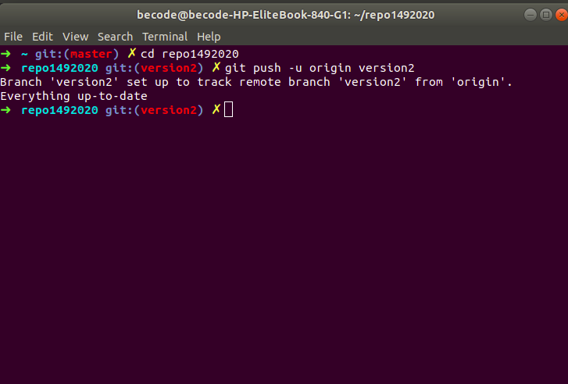
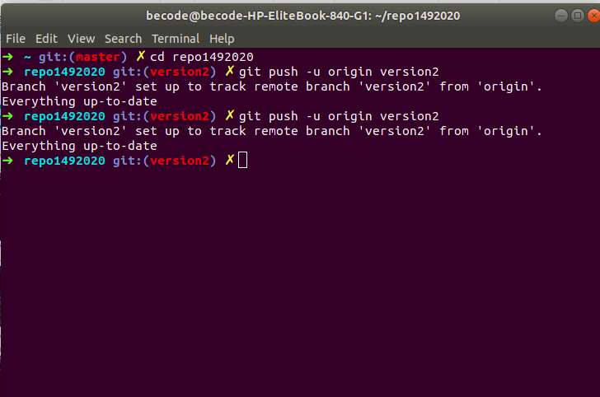

Slide 5


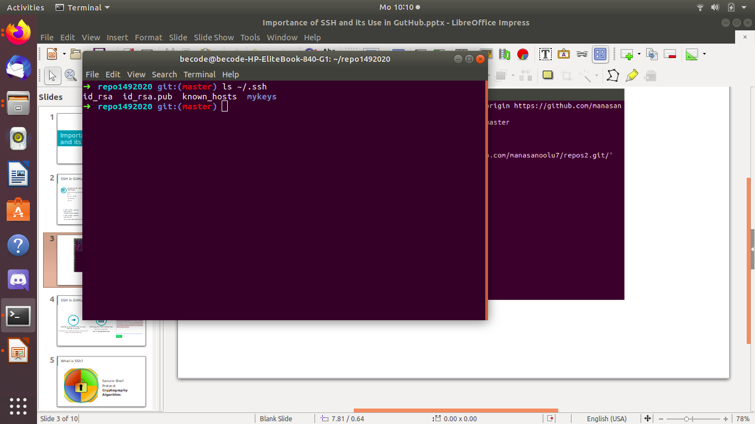
SSH in GitHub
Checking for existing SSH keys
Generating a new SSH key
Adding it to the ssh-agent
Before you generate an SSH key
generate a new SSH key to use for authentication add it to the ssh-agent
$ ssh-keygen -t rsa -C “your_email@example.com”
Enter a file in which to save the key (/home/you/.ssh/id_rsa): [Press enter]
> Enter passphrase (empty for no passphrase): [Type a passphrase]
> Enter same passphrase again: [Type passphrase again]
ssh-agent -s
> Agent pid 59566
ssh-add ~/.ssh/id_rsa
$ git config --global user.name "YOUR_USER_NAME"
$ git config --global user.email "your_email@domain.com"
Notes:
<number>

Slide 6
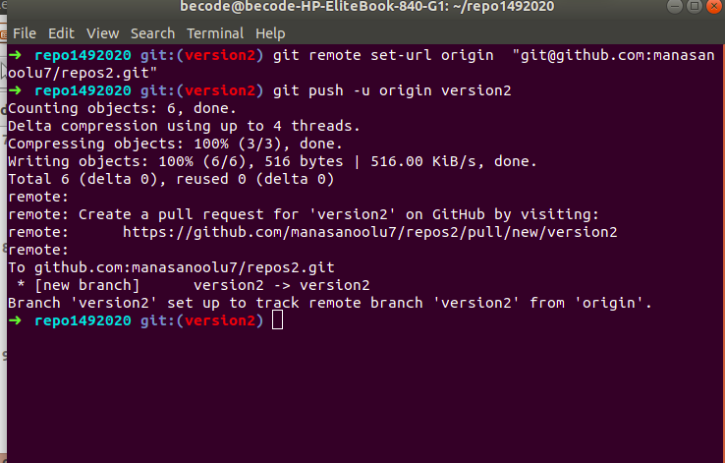

Slide 7
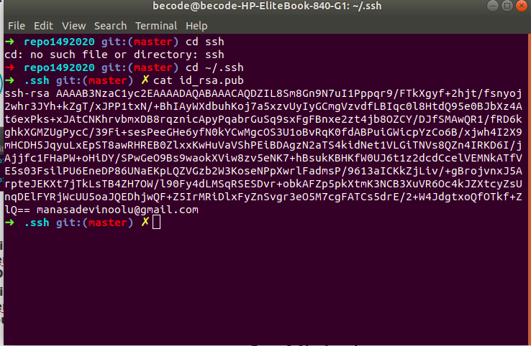

Slide 8
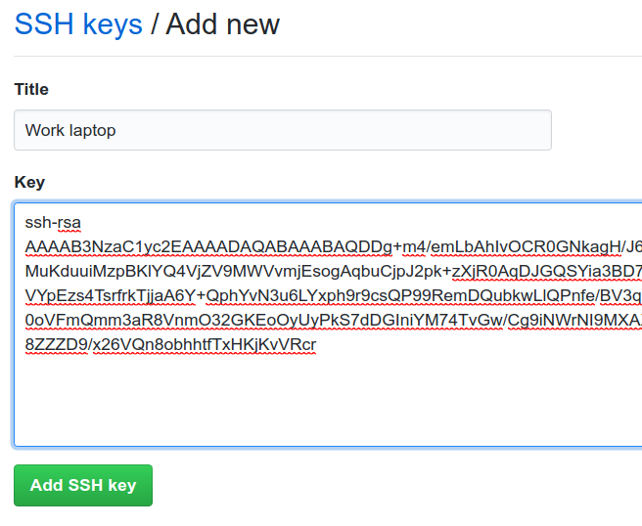


SSH in GitHub
Adding a new SSH key to your GitHub account
Testing your SSH connection
test the connection
ssh -T git@github.com
configure your GitHub account to use your new or existing SSH key
Notes:
<number>

Slide 9

What is SSh?
Secure Shell
Protocol
Cryptography Algorithm
Notes:
<number>

Slide 10

Notes:
<number>

Slide 11
How it works
1
Verification of the server by the client
3
Authentication of the client
2
Generation of a session key to encrypt all the communication
Notes:
<number>

Slide 12
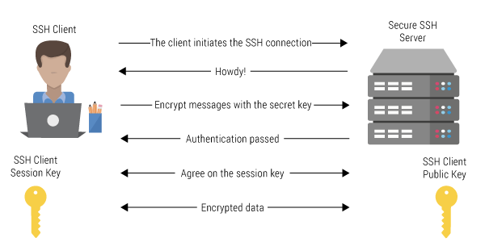
Notes:
<number>

Slide 13

Uses
secure communications between a local machine and a remote host
managing routers, server hardware, virtualization platforms and file transfer applications
single sign-on (SSO)
Notes:
<number>

Slide 14

Thank you
Notes:
<number>

